Slide 1
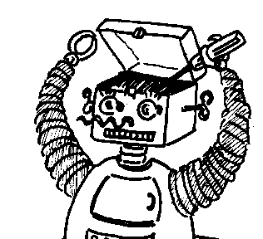
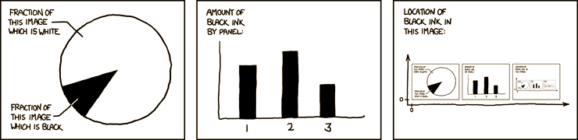

Maryland Metacognition Seminar
http://xkcd.com/
Metacognition as Kludge
Peter Carruthers
Philosophy, University of Maryland, College Park
9 December 2011, 12:00 PM
A. V. Williams Bldg., RM. 3258, College Park
Abstract:
This talk considers the cognitive architecture of human metacognition (defined as psychologists define it, as "thinking about thinking"). Many people have tended to model metacognitive competence in general in terms of a dedicated “meta-level” system designed for monitoring and controlling first-order mental processes. The perspective defended in this talk, in contrast, is that metacognition is a cobbled-together skill comprising diverse self-management strategies, which are acquired through individual and cultural learning, and which approximate the postulated monitoring-and-control functions by recruiting mechanisms that were designed for quite other purposes.

